Slide 1


SONGS ANALYSIS
(USING POWER BI)
- SHAKEEB QURESHI

Slide 2

PROBLEM STATEMENT
In the rapidly evolving digital landscape, YouTube has become a primary platform for music consumption, providing content creators and stakeholders with vast opportunities to engage audiences. However, the sheer volume of data generated poses a significant challenge in identifying meaningful patterns, trends, and insights. This project aims to conduct a comprehensive analysis of YouTube songs data using Power BI to address Exploratory Data Analysis, Temporal Trends, Content and User Engagement Insights.

Slide 3
DATASET DESCRIPTION
video_id: Unique identifier for each YouTube video.
channelTitle: Title of the YouTube channel publishing the song.
title: Title of the YouTube song video.
description: Description provided for the YouTube song video.
tags: Tags associated with the YouTube song video.
publishedAt: Date and time when the YouTube song video was published.
viewCount: Number of views received by the YouTube song video.
likeCount: Number of likes received by the YouTube song video.
favoriteCount: Number of times the YouTube song video has been marked as a favorite.
commentCount: Number of comments posted on the YouTube song video.
duration: Duration of the YouTube song video.
definition: Video definition or quality (e.g., HD, SD).
caption: Availability of captions for the YouTube song video.

Slide 4
OVERVIEW OF ANALYSIS
EXPLORATORY DATA ANALYSIS
Patterns and Trends in View counts, Like counts, and Comments.
Popularity and engagement of YouTube song videos.
TEMPORAL TRENDS
YouTube song video metrics trends over time.
Peak publishing times and their impact on engagement.
CONTENT & USER ENGAGEMENT
Relationships between likes, comments, and views.
Factors influencing user engagement with YouTube song videos.
Popular tags and their correlation with view counts.

Slide 5
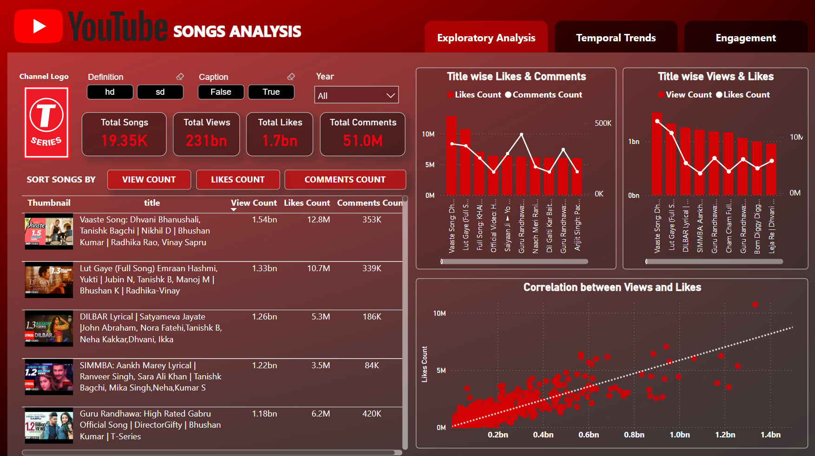

Slide 6
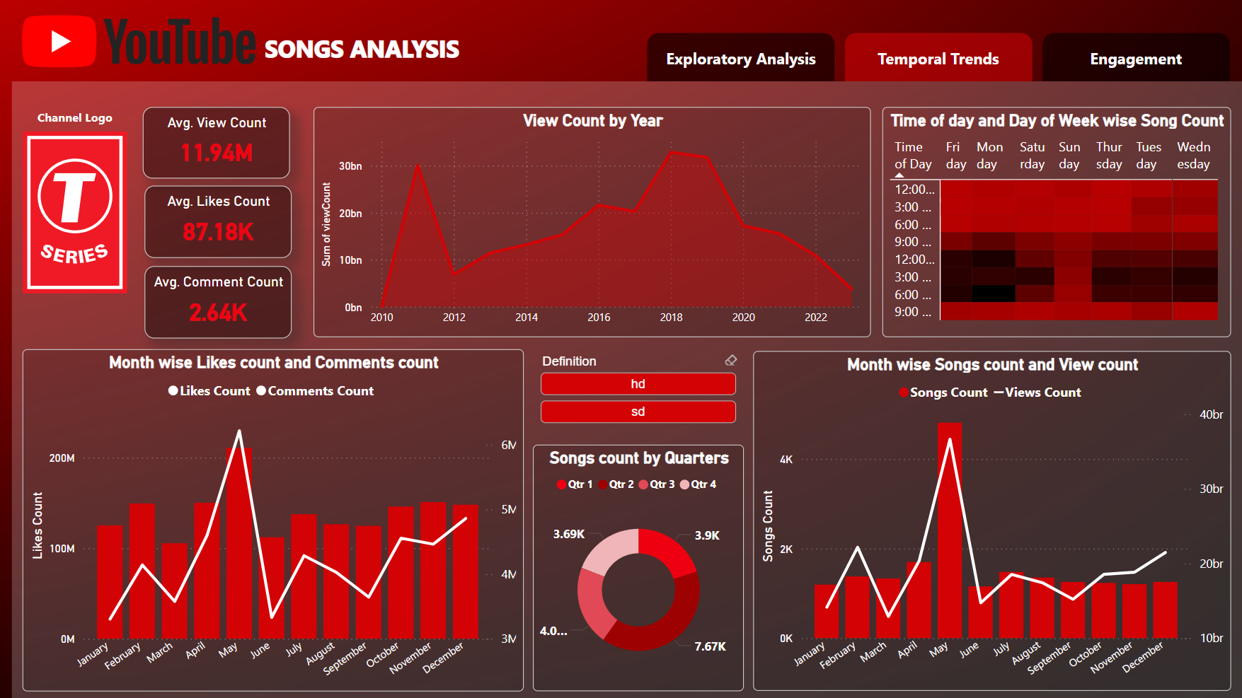

Slide 7
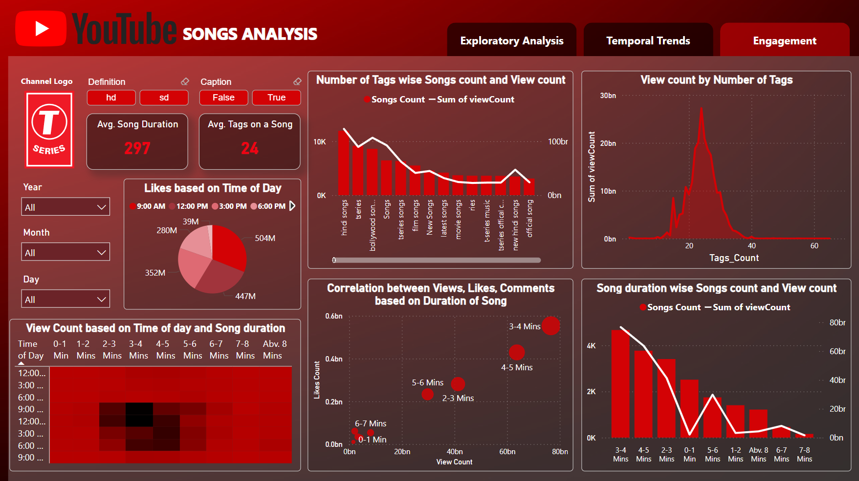

Slide 8
Recommendations for content creators and stakeholders to enhance YouTube song video performance.
Utilize Relevant Hashtags Strategically:
Incorporate a precise and relevant set of hashtags to enhance the discoverability and reach of the video.
Optimize Video Length:
Aim for video durations between 3 to 5 minutes to maintain viewer engagement and maximize retention rates.
Post at Optimal Times:
Schedule video postings between 9 AM and 3 PM to align with peak viewer activity and increase visibility.
Prefer Weekdays for Posting:
Publish videos on weekdays, as audience engagement tends to be higher compared to weekends.

Slide 9
Recommendations for content creators and stakeholders to enhance YouTube song video performance.
Maintain High Definition Quality:
Ensure videos are produced in HD quality to meet viewer expectations and enhance user experience.
Leverage Positive Correlation Between Views and Likes:
Focus on strategies to increase likes, such as encouraging viewers to like the video, as this will likely lead to an increase in view counts due to the positive correlation.
Optimize Descriptions and Titles:
Craft keyword-optimized descriptions and titles to improve search visibility and attract a broader audience.
Regularly Analyze Performance Metrics:
Continuously monitor key performance indicators (KPIs) to identify trends and adjust strategies accordingly.

Slide 10

THANK
YOU

